Slide 1
Question 1
A class of students has measured their heights.
146, 148, 151, 153, 153, 154, 154, 156, 156, 156,
157, 157, 159, 162, 162, 163, 163, 164, 164, 165,
165, 168, 168, 173, 174, 177, 181.
Calculate the mean, mode, median and range?
How could we present this information diagrammatically?
With a partner, name five types of graphs you might see in advertising.

Slide 2
Pie Chart, Line graph, Dot Plot, Scatter Plot, Histogram…
But wait…
What is a Histogram?
Median
“Put them in order and find the middle”
Mean
“Add them all up and divide by how many there are”
Range
“Biggest take away the smallest”
Mode
“Most common number”
What type of graphs do you know?
Mean = 4349 / 27 = 161.07 (2.d.p.)
Mode = 156
Median = 162
Range = 181 – 146 = 35

Slide 3

Histograms

Slide 4
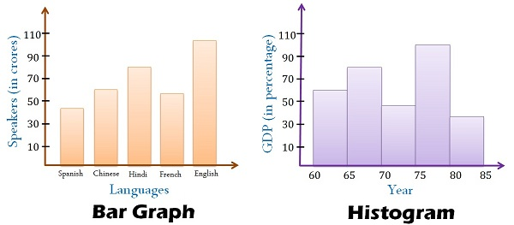
Today’s lesson is about histograms.
A histogram looks a lot like a column graph but there are a couple of key differences.
Gaps
No Gaps
Data is categorical and bars can be swapped around
Data is continuous numerical and columns cannot be swapped around

Slide 5
Question 2
A bar chart has ____________ between the columns while a
Histogram _____________. A bar chart displays
______________________ data while a histogram displays
_________________________ data.
gaps
does not
categorical
continuous
numerical

Slide 6
24
7
30
Histograms
Date
EQ – What steps do I follow to create a histogram?
What is a histogram?
A histograms shows the frequency of continuous numerical data.
Notes:
iler

Slide 7
24
7
30
Histograms
Date
EQ – What steps do I follow to create a histogram?
What is a histogram?
A histograms shows the frequency of continuous numerical data.
List the steps to create a histogram?
Look at the range of the data to help decide on a “class width”.
Lets look at the data we used for the warm up.
146, 148, 151, 153, 153, 154, 154, 156, 156, 156, 157, 159, 162, 162, 163, 163, 164, 164, 165, 165, 168, 168, 173, 174, 177, 181.
The range was found to be 35.
I want to create a histogram with between 5 and 20 “classes” (or columns). If you can choose a class width using a number that is easy to calculate with. A class width of 10 creates only 4 classes, while a class width of 5 (starting at 145) creates 8 classes. A class width of 2 is possible but will create 16 classes many of which will have only 1 or 2 results in them.
Notes:
iler

Slide 8
24
7
30
Histograms
Date
EQ – What steps do I follow to create a histogram?
What is a histogram?
A histograms shows the frequency for continuous numerical data.
List the steps to create a histogram?
Look at the range of the data to help decide on a “class width”.
Use the class width to create a frequency table.
We have decided to use class widths of 5. Lets create a frequency table from our data.
146, 148, 151, 153, 153, 154, 154, 156, 156, 156, 157, 157, 159, 162, 162, 163, 163, 164, 164, 165, 165, 168, 168, 173, 174, 177, 181.
145 – 149
150 – 154
155 – 159
160 – 164
165 – 169
170 – 174
175 – 179
180 – 184
|| = 2
|||| = 5
||||| = 6
||||| = 6
|||| = 4
|| = 2
| = 1
| = 1
Question 3
Notes:
iler

Slide 9
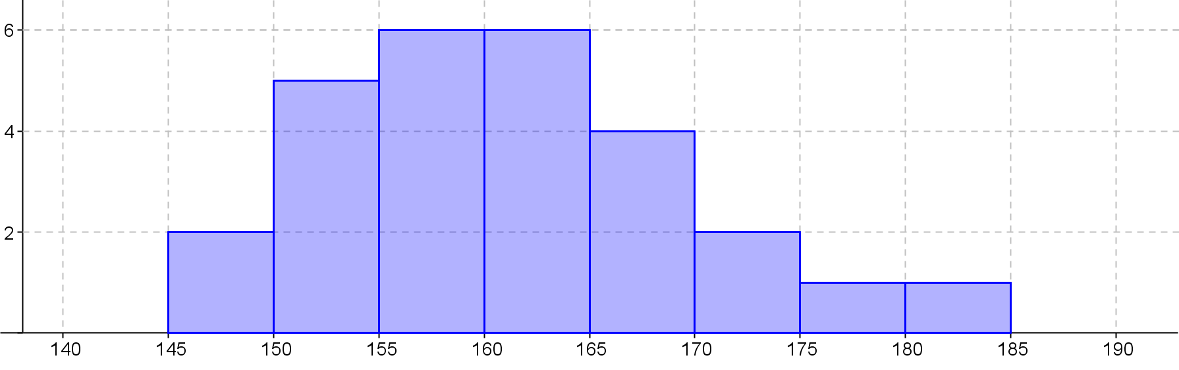
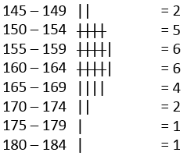
24
7
30
Histograms
Date
EQ – What steps do I follow to create a histogram?
What is a histogram?
A histograms shows the frequency for continuous numerical data.
List the steps to create a histogram?
Look at the range of the data to help decide on a “class width”.
Use the class width to create a frequency table.
Create a set of Axis that will accommodate all the data we wish to show.
Frequency
Our maximum frequency is 6 so our y axis must go to at least 6 and we use our class widths to determine the x axis
Height(cm)
Notes:
iler

Slide 10
24
7
30
Histograms
Date
EQ – What steps do I follow to create a histogram?
What is a histogram?
A histograms shows the frequency for continuous numerical data.
List the steps to create a histogram?
Look at the range of the data to help decide on a “class width”.
Use the class width to create a frequency table.
Create a set of Axis that will accommodate all the data we wish to show.
Use the frequency data from the frequency table to complete the graph and add a title.
Heights of students in 8 -7
Title
Frequency
No Gaps between the columns
Labels
Height(cm)
Notes:
iler

Slide 11
24
7
30
Date
Histograms
EQ – What steps do I follow to create a histogram?
Key Points
Decide on the class width
Create a frequency table
Use a ruler and pencil to draw axes
Equal bar widths
No Gaps between bars
Title and Labels
Notes:
iler

Slide 12
Summary:
Histograms display ______________ _______________ data without any ________.
To create histograms we need to decide on appropriate _________________ and then create a ______________ table.
Sentence Frame- WICOR
continuous
numerical
gaps
scale
frequency
EXIT PASS
Completed summary allows you to leave the class.
Notes:
Histograms display continuous numerical data without any gaps. To create histograms we need to decide on appropriate class width sizes and then create a frequency table.

